Slide 1
Thermodynamics
First Law of Thermodynamics

Slide 2
First Law of Thermodynamics
that energy cannot be created nor destroyed.
Therefore, the total energy of the universe is a constant.
Energy can, however, be converted from one form to another or transferred from a system to the surroundings or vice versa.

Slide 3
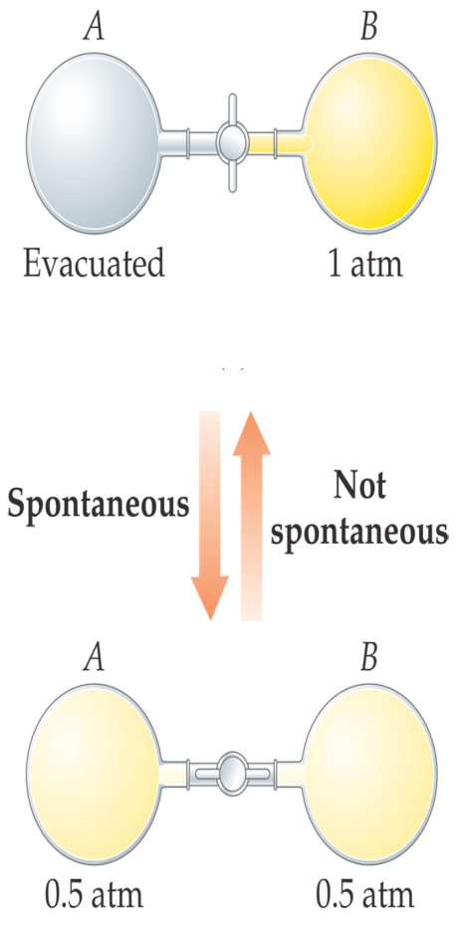
Spontaneous processes are those that can proceed without any outside intervention.
The gas in vessel B will spontaneously effuse into vessel A, but once the gas is in both vessels, it will not spontaneously

Slide 4
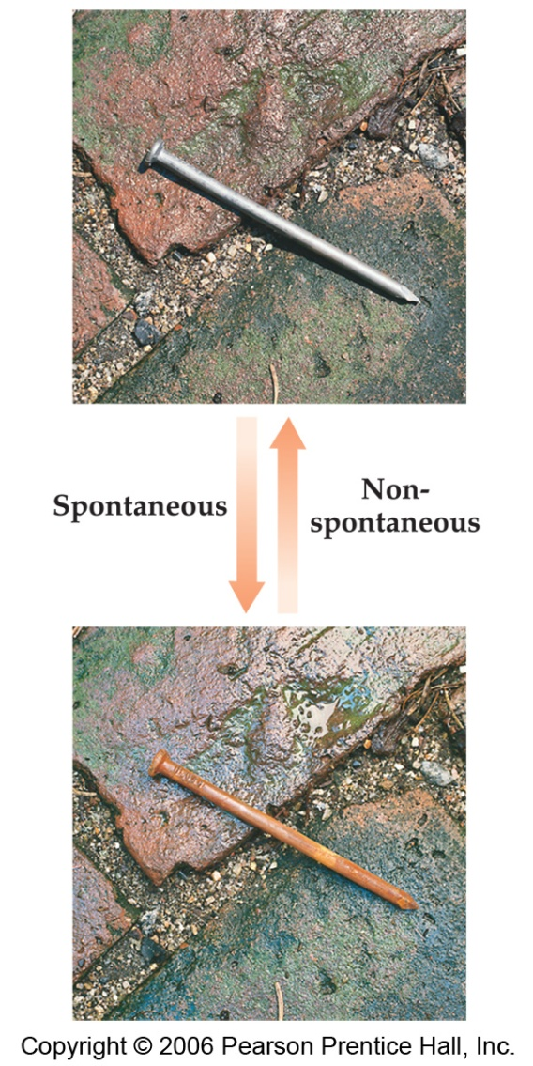
First Law of Thermodynamics
Processes that are spontaneous in one direction are nonspontaneous in the reverse direction.

Slide 5
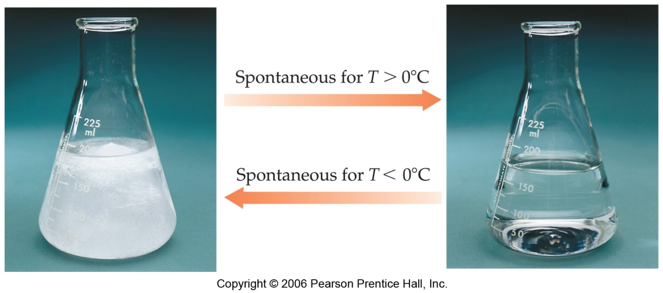
Spontaneous Processes
Processes that are spontaneous at one temperature may be nonspontaneous at other temperatures.
Above 0°C it is spontaneous for ice to melt.
Below 0°C the reverse process is spontaneous.

