Slide 1
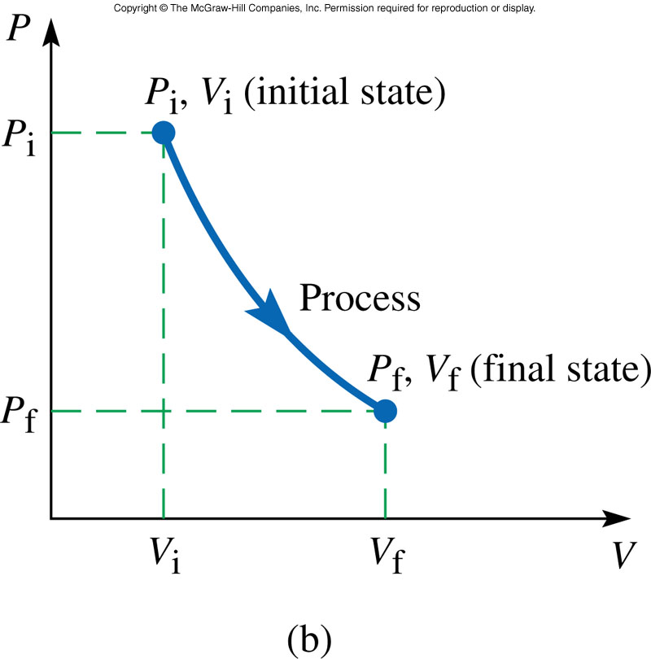
Thermodynamic Processes
A thermodynamic process is represented by a change in one or more of the thermodynamic variables describing the system.
Each point on the curve represents an equilibrium state of the system.
Our equation of state, the ideal gas law (PV = nRT), only describes the system when it is in a state of thermal equilibrium.

Slide 2
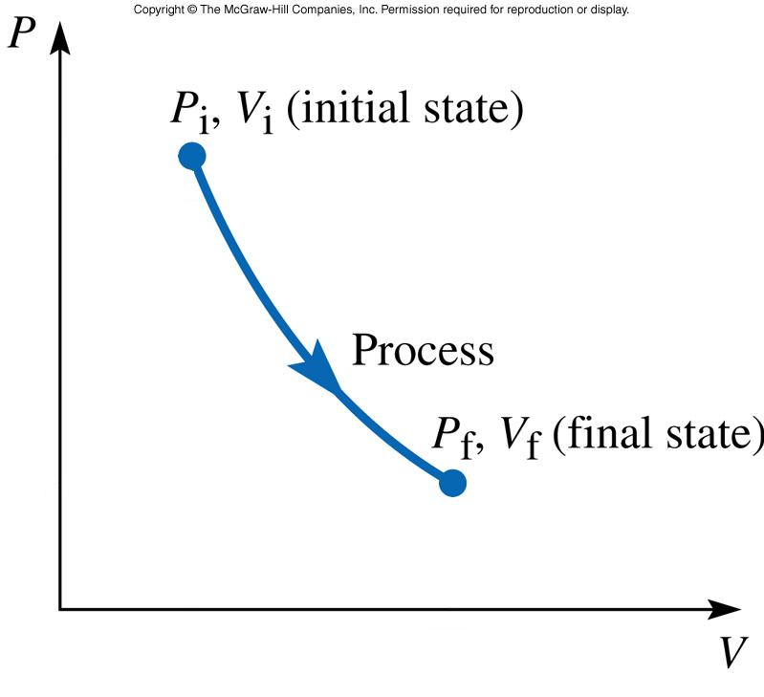
Reversible Thermodynamic Process
For a process to be reversible each point on the curve must represent an equilibrium state of the system.
The ideal gas law (PV = nRT), does not describe the system when it is not in a state of thermal equilibrium.
Reversible Process
Irreversible Process

Slide 3
Thermodynamic Processes
A PV diagram can be used to represent the state changes of a system, provided the system is always near equilibrium.
The area under a PV curve gives the magnitude of the work done on a system. W>0 for compression and W<0 for expansion.

Slide 4
To go from the state (V_{i}, P_{i}) by the path (a) to the state (V_{f}, P_{f}) requires a different amount of work then by path (b). To return to the initial point (1) requires the work to be nonzero.
The work done on a system depends on the path taken in the PV diagram. The work done on a system during a closed cycle can be nonzero.

Slide 5
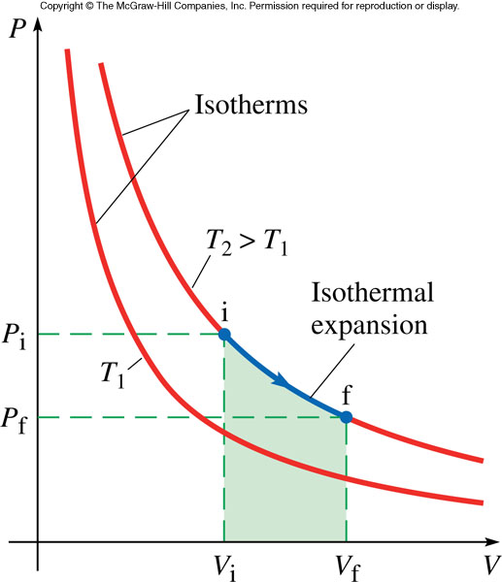
An isothermal process implies that both P and V of the gas change (PV∝T).

Slide 6
Summary of Thermodynamic Processes

Slide 7
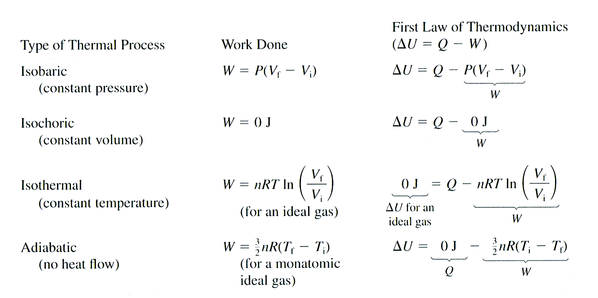
Summary of Thermal Processes
The First Law of Thermodynamics

