Slide 1
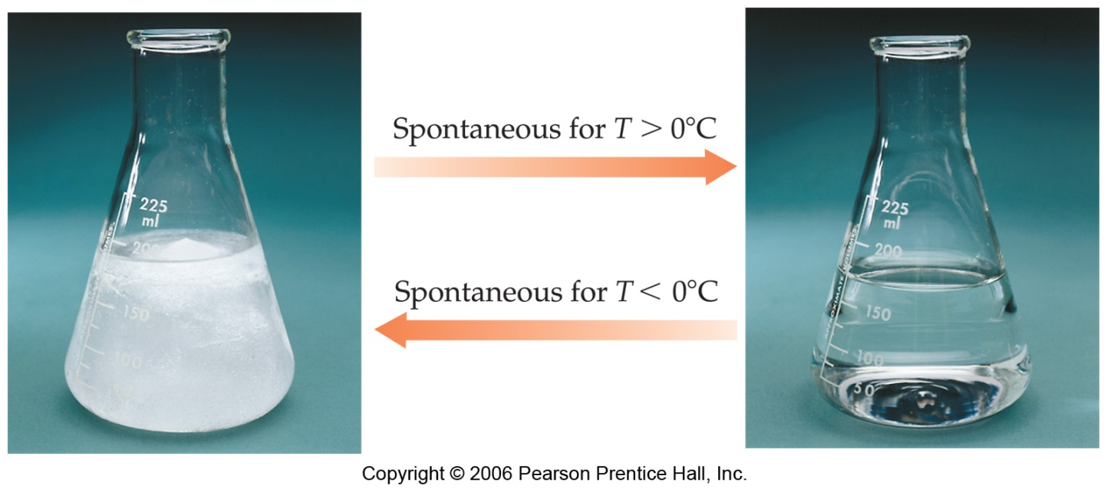
Spontaneous Processes
Processes that are spontaneous at one temperature may be nonspontaneous at other temperatures.
Above 0°C it is spontaneous for ice to melt.
Below 0°C the reverse process is spontaneous.

Slide 2
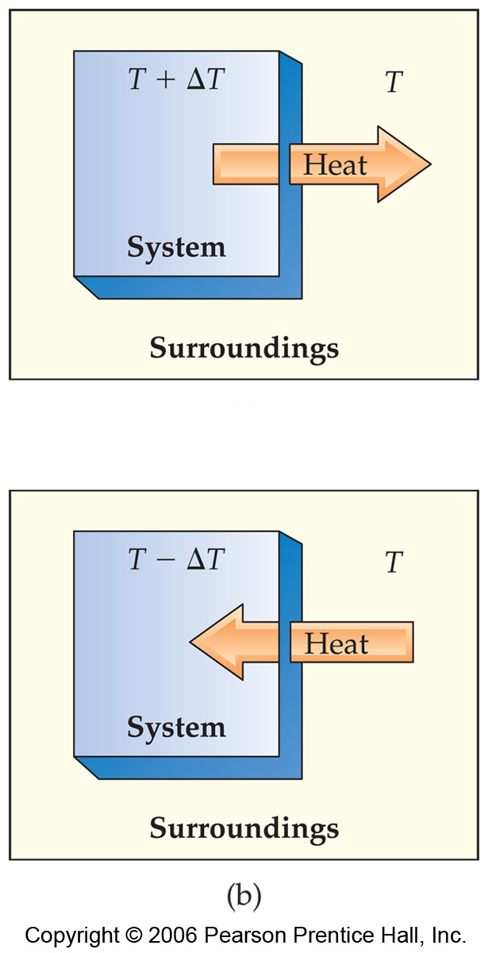
Reversible Processes
In a reversible process the system changes in such a way that the system and surroundings can be put back in their original states by exactly reversing the process.
Changes are infinitesimally small in a reversible process.

Slide 3
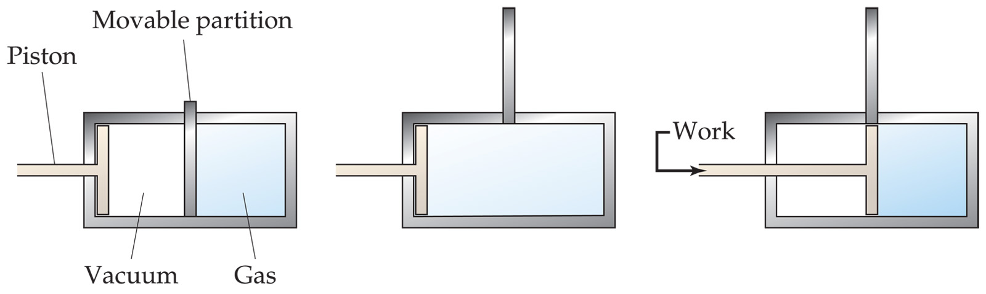
Irreversible Processes
Irreversible processes cannot be undone by exactly reversing the change to the system.
All Spontaneous processes are irreversible.
All Real processes are irreversible.

