Slide 1
BANGLADESH TECHNICAL EDUCATION BOARD
DIPLOMA IN ENGINEERING
POWER TECHNOLOGY
4 th semester
Subject: Suspension, Brake, Steering &
Transmission System of Vehicle (26262)
Aminul ISLAM MUhIB
JUNIOR INSTRUCTOR
POWER TECHNOLOGY
Sylhet polytechnic institute, stlhet
Lesson 02

Slide 2
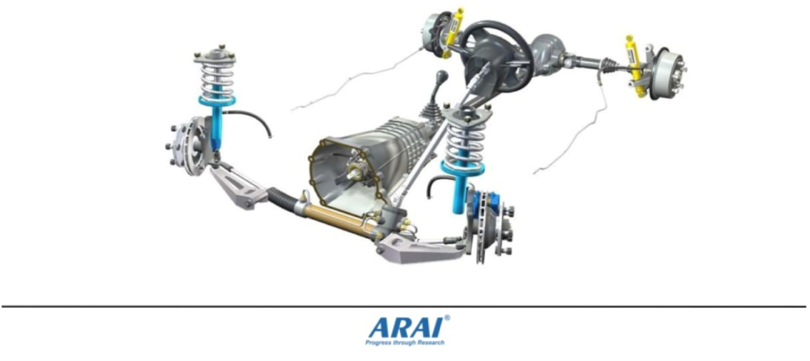
Power transmission system
BE Skilled BE
Smart
By
Tejas Sharma

Slide 3
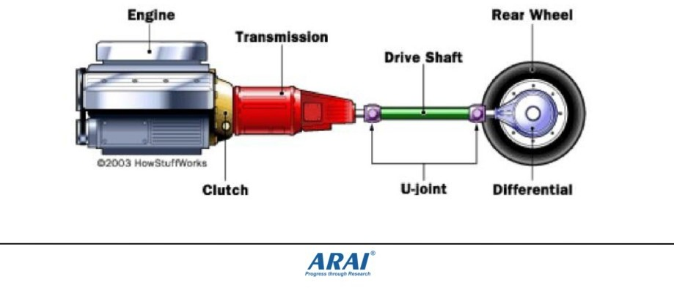
Power transmission system
Function of transmission:
- It is used to transmit engine torque to the driving wheels to drive the vehicle on the road.

Slide 4
Requirement of Transmission System
To provide for disconnecting the engine from the driving wheels
When engine is running , connect the driving wheels to engine smoothly without shock
Leverage between engine and driving wheels to be varied
Enable the driving wheels to rotate at different speeds.
Provide relative movement between engine and driving wheels

Slide 5
Transmission System - Layout

Slide 6
Transmission Types

