Slide 1
BANGLADESH TECHNICAL EDUCATION BOARD
DIPLOMA IN ENGINEERING
POWER TECHNOLOGY
4 th semester
Subject: Suspension, Brake, Steering &
Transmission System of Vehicle (26262)
SANJOY BANIK
JUNIOR INSTRUCTOR
POWER TECHNOLOGY
Sylhet polytechnic institute, stlhet
Lesson 03

Slide 2
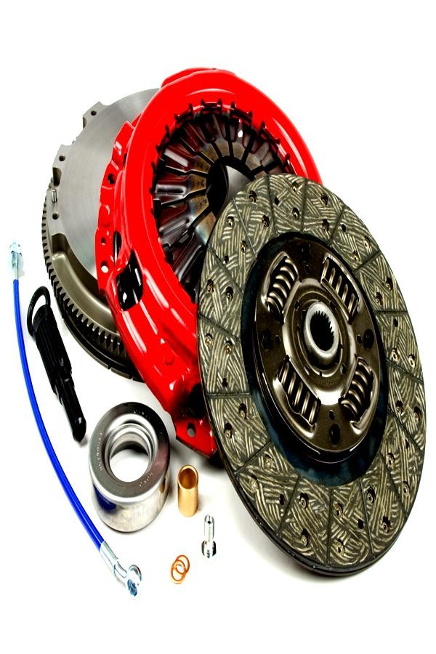

Slide 3
“A clutch is a mechanical device which engages and disengages power transmission especially from driving shaft to driven shaft.”
In the simplest application, clutches connect and disconnect two rotating shafts (drive shafts or line shafts).
In these devices, one shaft is typically attached to an engine or other power unit (the driving member) while the other shaft (the driven member) provides output power for work.

Slide 4
The very first principle on which a clutch works is friction. When two revolving friction surfaces are brought into contact and pressed, then they are united and start revolve at same speed due to friction force between them. This is the basic principle of clutch.
The friction between these two surfaces depends on the area of surface, pressure applied upon them and the friction material between them.

Slide 5
The driving member of
a clutch is the flywheel
mounted on the engine crankshaft and the driven member is pressure plate mounted on the transmission shaft.
Some friction plates, sometimes known as clutch plates are kept between these two members. This whole assembly is known as the clutch.

Slide 6
An automobile clutch has following function:
It can be disengaged. This allows engine cranking and permits the engine to run without delivering power to the transmission.
While disengaging, it permits the driver to shift the transmission into various gear according to operating condition.

Slide 7
3. While engaging, the clutch slips momentarily. this provides smooth engagement and lessens the shock on gears, shaft and other parts of automobile.
4. While engaging, the clutch transmits the power to the wheel without slipping, in ideal condition.

Slide 8
1. Driving member:
It is the member which is directly connected to the crankshaft. The driving member consists of a cover which carries the pressure plate (driving disc), the pressure springs and the releasing lever. This entire assembly is bolted on the flywheel and rotates with engine all the time. The flywheel and the pressure plate grip the driven member between them under the action of the pressure spring.

Slide 9
Driven member:
The driven member consists of a plate which is free to slide lengthwise on the splines of the clutch shaft but which drives the shaft through those splines. This plate is known as friction plate. The clutch housing also includes in the driven member.
Operating member:
The operating member connects the driver to this whole assembly. It consist the foot pedal, the linkage, the release lever and springs necessary to ensure proper operation of the clutch.

Slide 10
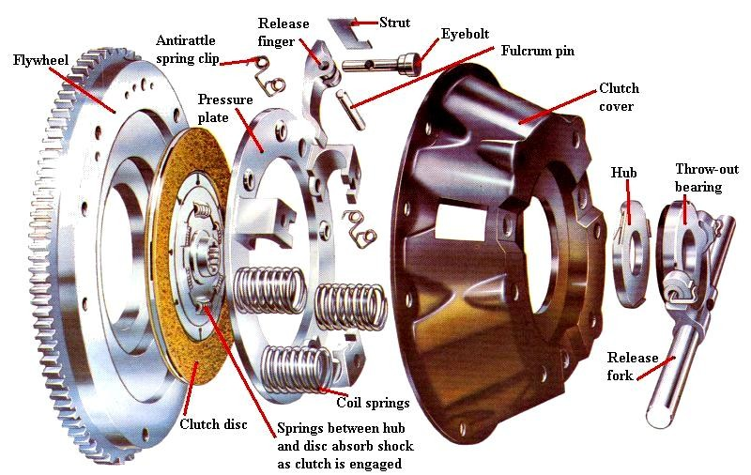

Slide 11
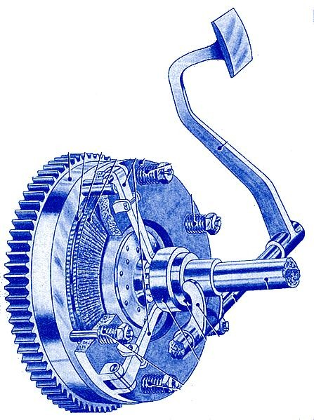

Slide 13
1. Friction Clutch
Cone clutch
Single plate clutch
Multi-plate cutch
Semi-centrifugal clutch
Centrifugal clutch
2. Fluid flywheel
Fluid coupling
Torque converter.

Slide 14
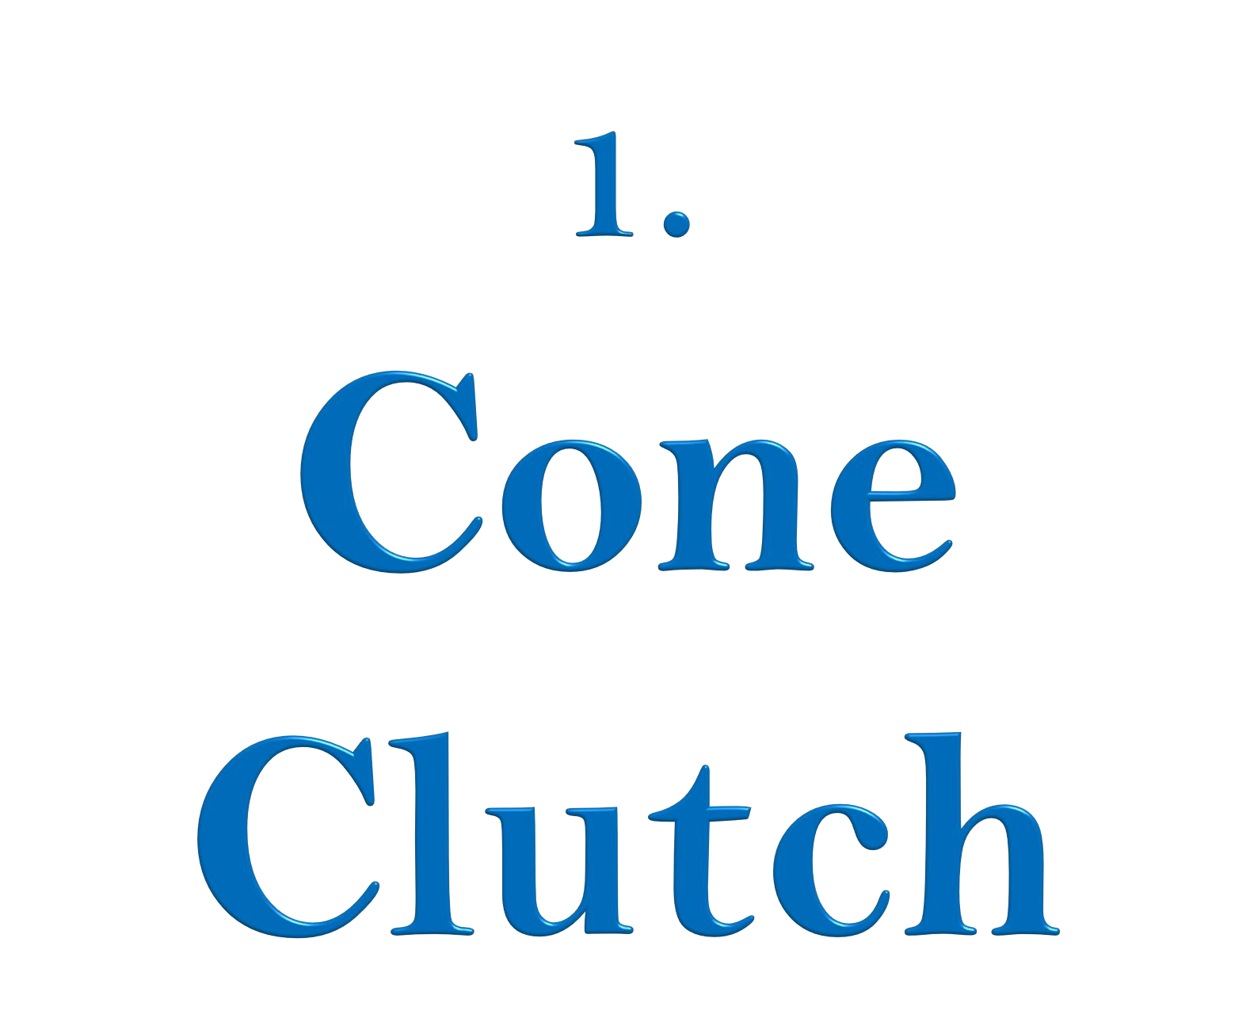

Slide 15
1. Cone Clutch
A cone clutch
“oldest of all” is a type of
clutch system in which two mating members known
as the male member
and the female member
designed in shape of cones are used, due to the mating of these two members frictional force due to the frictional contact between them is generated results in torque or power.
The engagement and disengagement of the male and female member of the cone clutch is controlled by the clutch pedal.

Slide 16
Female Cone- It is the part of a cone which is connected to the flywheel of the engine and also rotates with it, this cone is having inner cutting cone shaped groove over which the male cone interlocks and make frictional contact with it in order to engage the drive.
Male Cone- It is the part of a cone clutch which is connected to the transmission shaft and is machined in the shape of a solid cone over which frictional material is attached.

Slide 17
Spring – Normal thrust spring located behind the male cone is used for engagement and disengagement of the clutch.
Shafts- The female cone which is directly attached to the flywheel is mounted over a solid shaft.
Sleeves- Sleeves having inner splines attached to the male cone mounted over the splined shaft is used for the to and fro motion of the male cone.
Pedal– A clutch pedal operated by the driver is used for input regarding the engagement and the disengagement of the clutch.

Slide 18
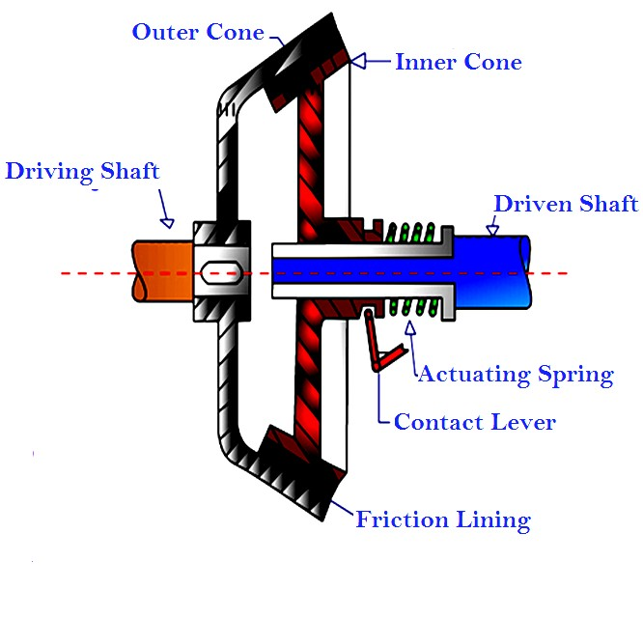

Slide 20
Less wear and tear compare to positive displacement clutch.
It is silent in operation.
The normal force acting on the contact surface is larger than the axial force generated by the springs.
Comparatively higher torque can be transmitted than same size of plate clutch.

Slide 21
Operation of the clutch is highly depended on the cone angle. If the cone angle is smaller than 20 degree, it becomes difficult to disengage the clutch.
Frequent maintenance required because the small amount of wear on the cone surface results in a considerable amount of the axial movement of the inner cone.

Slide 23
2. Single Plate Clutch
It is a type of friction clutch in which power is transmitted by means of friction between the contact surface usually called clutch plates.
As name suggest a this clutch consists of only one clutch plate with both side friction lining (frictional surface).
These surfaces have high Coefficient of friction. Single plate clutch also called dry clutch because no lubricant is used as coolant.

Slide 24
1. Clutch plate:
In single plate clutch only one clutch plate is used. Clutch plate is main component of clutches. It is thin disc type metallic plate having both side frictional surfaces. Frictional surfaces on plate must be of such material to provide friction for transmitting torque without sleeping. The coefficient of friction of contact surfaces should be high for proper connection without slipping. Clutch plate is assembled in between flywheel and pressure plate.

Slide 25
Pressure plate:
The pressure plate which is generally made up of cast iron. It helps in applying pressure on clutch plates to maintain the proper contact between the surfaces of flywheel and clutch plate by means of spring which are attached to it.
Springs:
Springs are used to maintain the pressure on pressure plate for proper connection between clutch plate and flywheel and prevent the slipping of contact surfaces.

Slide 26
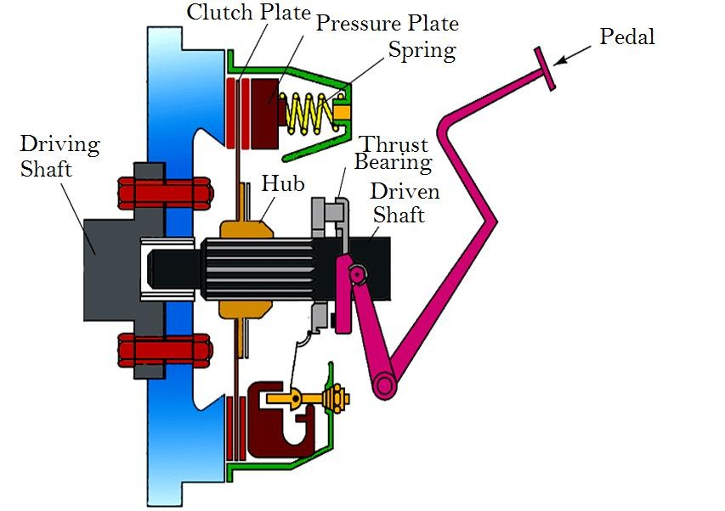

Slide 27
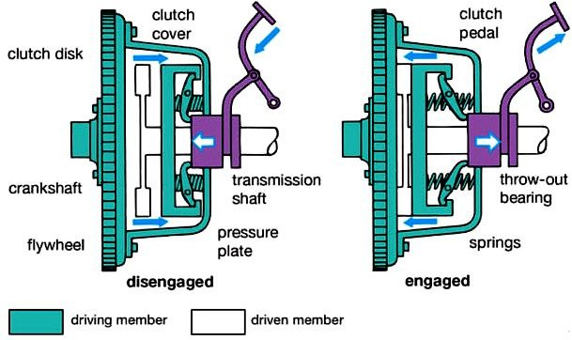

Slide 29
4. Flywheel:
Flywheel is attached to engine output and its other side comes in contact with clutch plate when pressure is applied by the pressure plate.
Operating mechanism:
This includes foot pedal, linkage, bearing and lever etc. All these components are connected in a sequence. Foot pedal is located inside the automobiles; a lever mechanism is attached with foot pedal which transmit the motion from pedal to spring by means of thrust bearings.

Slide 30
A lever is attached to the paddle which is responsible for the force transmission from the paddle.
When pedal is pressed spring is compressed and engine is free to move without any load.
Lever is attached in such a manner when we press the clutch paddle thrust bearing moves forward and pressure plate moves backward or it moves away from the flywheel; due to this the connection between the clutch plate and flywheel released and shafts are disengaged.

Slide 31
This time we can easily change gears in case of automobiles. Again if we want to engage the shafts just release the clutch paddle; then springs attached to the pressure plate push the pressure plate forward.

Slide 32
The working of the single plate clutch is smooth i.e. the engagement and disengagement is very smooth in operation
Less slip occurs in it; slip is occurs only at the time of engagement after engagement no slip occurs and the functioning becomes very smooth.
Power losses are very less.
Less heat generates because only single plate is used. Heat generation creates problem in power transmission and can damage the working parts.

Slide 33
It has less torque transmitting capacity.
It has bigger in size even for transmitting less torque.
It requires high maintenance because they are dry clutches and it is necessary to prevent them from moisture or any leakage of lubricant/oil in machinery.
Single plate clutches have high wear and tear rate and have less smooth engagement.
Applications:
These are used in large size automobiles where radial space is not constrain such as trucks and cars.

Slide 35
3. Multi Plate Clutch
As name suggest a this clutch consists of only one clutch plate with both side friction lining (frictional surface). A multi-plate clutch is a type of clutch that transmits more power from the engine to the transmission shaft of an automobile vehicle and also, makes up for the torque loss due to slippage.
Heavy machinery, commercial vehicles, special purpose military vehicles, racing cars and bikes use this type of clutch.

Slide 36
Scooters and motor-cycles use multi-plate clutches due to limited space in their gearboxes.
Multiple clutches consist of more than three discs or plates so that it is able to provide more torque output.

Slide 37
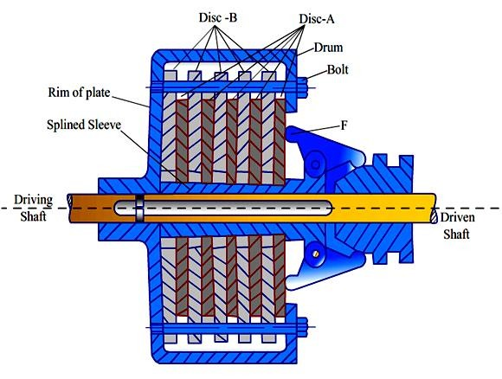

Slide 39
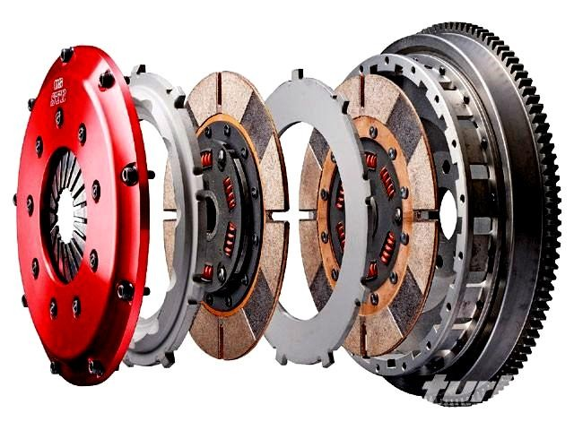

Slide 40
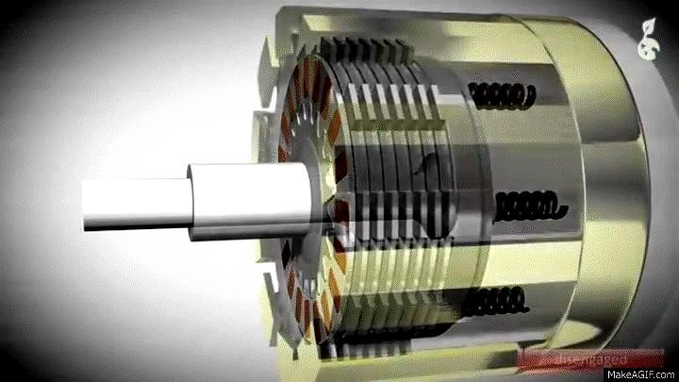

Slide 41
Spring type Multi-Plate Clutch
Diaphragm type Multi-Plate Clutch
Hydraulic Operated or Automatic Transmission Multi-Plate Clutch
1. Spring type Multi-Plate Clutch: In this type of Multi-Plate Clutch, a cover is bolted to the flywheel. Multiple clutch plate is found on the cover. The outer plates of the clutch apply thrust on the inner plates with the help of clutch springs or thrust springs to form a drive, thereby engaging the plates.

Slide 42
For the clutch disengagement, the mechanism withdraws the end plate to compress the springs and release the other plates. Old cars and bikes use this type of clutch.
2. Diaphragm type Multi-Plate Clutch: This type of clutch consists of a special crown shaped finger type spring, that is why the name diaphragm type. It does not come with thrust springs or clutches. During engagement of the clutch, the diaphragm bears against the outer ring and during disengagement, the reaction load is bear by the inner ring. Modern bikes and cars use this type of clutch.

Slide 43
3. Hydraulic Operated or Automatic Transmission Clutch: Automatic transmission vehicles use this type of clutch. A hydraulic device containing highly compressed fluid operating with the accelerated pedal is attached to the multi-plate clutch. The engagement and the disengagement of the clutch plates are received by the hydraulic device which is controlled with the accelerator pedal.

Slide 45
4. Semi Centrifugal Clutch
“Semi Centrifugal Clutches
used in high
where
powered clutch
engines and racing car engines
disengagements require appreciable and tiresome drivers effort.” The power transmitted with partly by clutch springs and remaining by the centrifugal action of an extra weight provided in the system.
The clutch springs transmit power at low engine speed and the centrifugal force transmit power at higher engine speed.

Slide 46
Besides clutch, pressure plate and splines shaft it mainly consists of:
Compression spring (3 numbers)
Weighted levers (3 numbers)
Engine Shaft
Flywheel
Clutch Shaft

Slide 47
When the engine at low speed the spring keeps the clutch engaged to transmit power, the weighted levers do not have any pressure on the pressure plate.
When engine at high speed the weights fly off and levers exert pressure on the pressure plate which keeps the clutch firmly engaged to transmit high torque.
Thus instead of having more stiff springs for keeping the clutch engaged firmly at high speeds, they are less stiff because of centrifugal forces of

Slide 48
weighted levers, so that the driver may not get any strain in operating the clutch.
when the engine speed decreases, the weights fall and the weighted levers do not exert any pressure on the pressure plate and only spring pressure is exerted on the pressure plate to keep the clutch engaged.

Slide 49
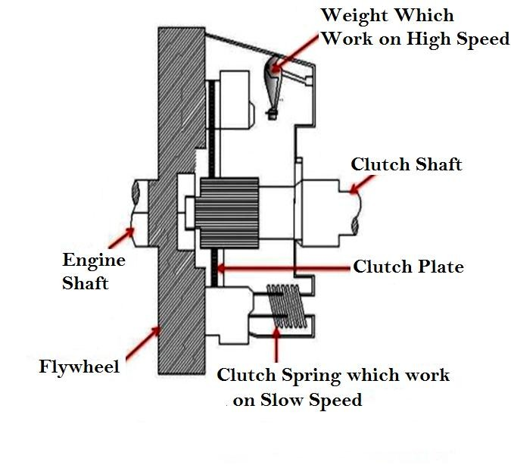

Slide 50
Advantages
Clutch operation is very easy.
Less stiff clutch springs are used as they operate only at low engine speeds.
Disadvantages
Springs have transmitted the torque at lower engine speeds only.
Centrifugal forces work only at higher engine speed to transmit torque.

Slide 51
Semi Centrifugal Clutch is used in Vauxhall car (foreign car).

Slide 53
5. Centrifugal Clutch
“Centrifugal Clutch uses centrifugal force instead of spring force. This clutch is always in engaged position.”
and it does not have a clutch pedal to operate it.
Centrifugal clutch is automatically operated with engine speed. The vehicle can be stopped in gear without stalling (stop running) the engine. And also the gear can be started in any gear by pressing the accelerator pedal.

Slide 54
A centrifugal clutch works on centrifugal force. One side of clutch connected to the engine crankshaft and other side connected to gearbox shaft, chain, or belt.
As engine R.P.M. (Revolutions Per Minute) increases, weighted arms in the clutch swing outward and force the clutch to engage position.
The most common Centrifugal Clutches have friction pads or shoes radially mounted that engage the inside of the rim of the housing.

Slide 55
On the center shaft (Driving or input shaft) there are an assorted amount of extension springs, which connect to a clutch shoe.
When the center shaft (Driving shaft) spins fast enough, the springs extend causing the clutch shoes to engage the friction face.
It can be compared to a drum brake in reverse order. The weighted arms force these disks together and engage the clutch and power transmitted.

Slide 56
When the (Revolutions
engine Per
shaft reaches
a certain RPM
Minute),
the clutch activates,
variable
working almost like a continuously transmission.
As the load increases the R.P.M. drops thereby disengaging the clutch and letting the RPM rise again and reengaging the clutch.

Slide 57
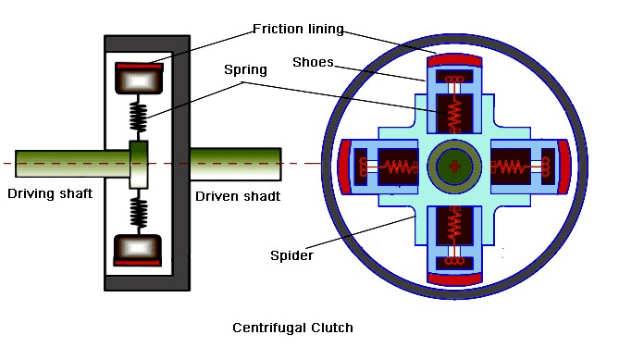

Slide 58
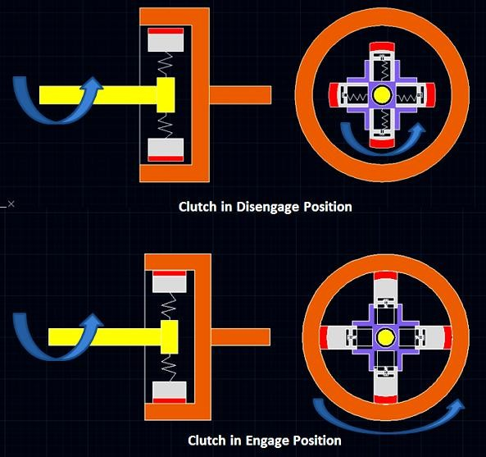

Slide 59
Advantages
Centrifugal Clutch has less maintenance.
It is not expensive.
It does not need clutch pedal because it’s automatic.
It helps to prevent the engine from stalling (stop running).
Disadvantages
Due to slipping and friction, There is a loss of power.
It causes overheating problems.
Its engagement and disengagements depend upon the speed of the driving shaft.

Slide 60
The centrifugal clutch is mainly used in mopeds and go-karts.
It is also used in mini bikes, chainsaw, and lawn mowers etc.
It is used in boats and Para-motors to keep the engine running during stalling (stop running) and disengage loads during starting and idling.

